Slide 1
Hackenbush on grid
Course No: CSE 4110
Course Title: Artificial Intelligence Laboratory
Presented By
Md. Shoriful Islam
Roll: 1807082
Arnob Sarker
Roll: 1807088

Slide 2
Gameplay Mechanics
One cell may contain multiple coins
2
There will be a 2-dimensional grid, and some coins. Each coin is placed on one cell of the grid.
1

Slide 3
Gameplay Mechanics
This is a two player sequential game. A person plays with AI.
Player makes the first move.
2

Slide 4
Gameplay Mechanics
In one move one player can:
Take away any single coin from the grid permanently
Move any single coin to any cell on the left from it’s current location in the same row
Move any single coin to any cell on the up from it’s current location in the same column
Each player will turn alternately and must make a move in their turn. The player who can not make any move loses the game.
3

Slide 5
Algorithm Model
4

Slide 6
How Green Hackenbush comes here
5

Slide 7
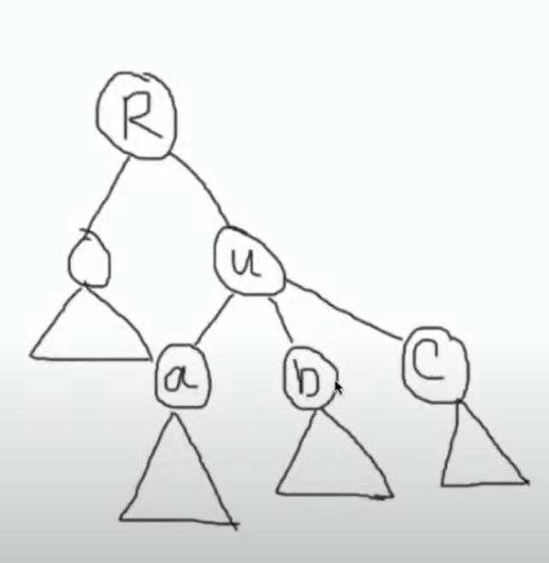
How AI plays the game: Colon Principle
Colon principle states that, when branches come together at a vertex, one may replace the branches by a non-branching stalk of length equal to their nim sum.
Let u have three children a, b, c
G(u) = (G(a)+1) ⊕ (G(b)+1) ⊕ (G(c)+1)
In this way, we can represent a tree as a nim pile.
Number of nim pile will be the number of coins present in the game.
We know that xor sum 0 is a losing state in nim game. So AI will move such a way that after moving the xor sum remains 0.
6

Slide 8
Thank You!

